Slide 1

COMPUTER ORGANISATION
&
ARCHITECTURE
PBCST404
MODULE 1
DHANYA PG
Asst. Professor, cse

Slide 2
BASIC OPERATIONAL CONCEPTS
How a Processor Executes a Program??
  The Fetch, Decode, Execute Cycle with Memory
A program is a list of instructions stored in the computer's memory.
The processor fetches instructions one by one from memory.
The data the instructions need (operands) are also stored in memory.

Slide 3
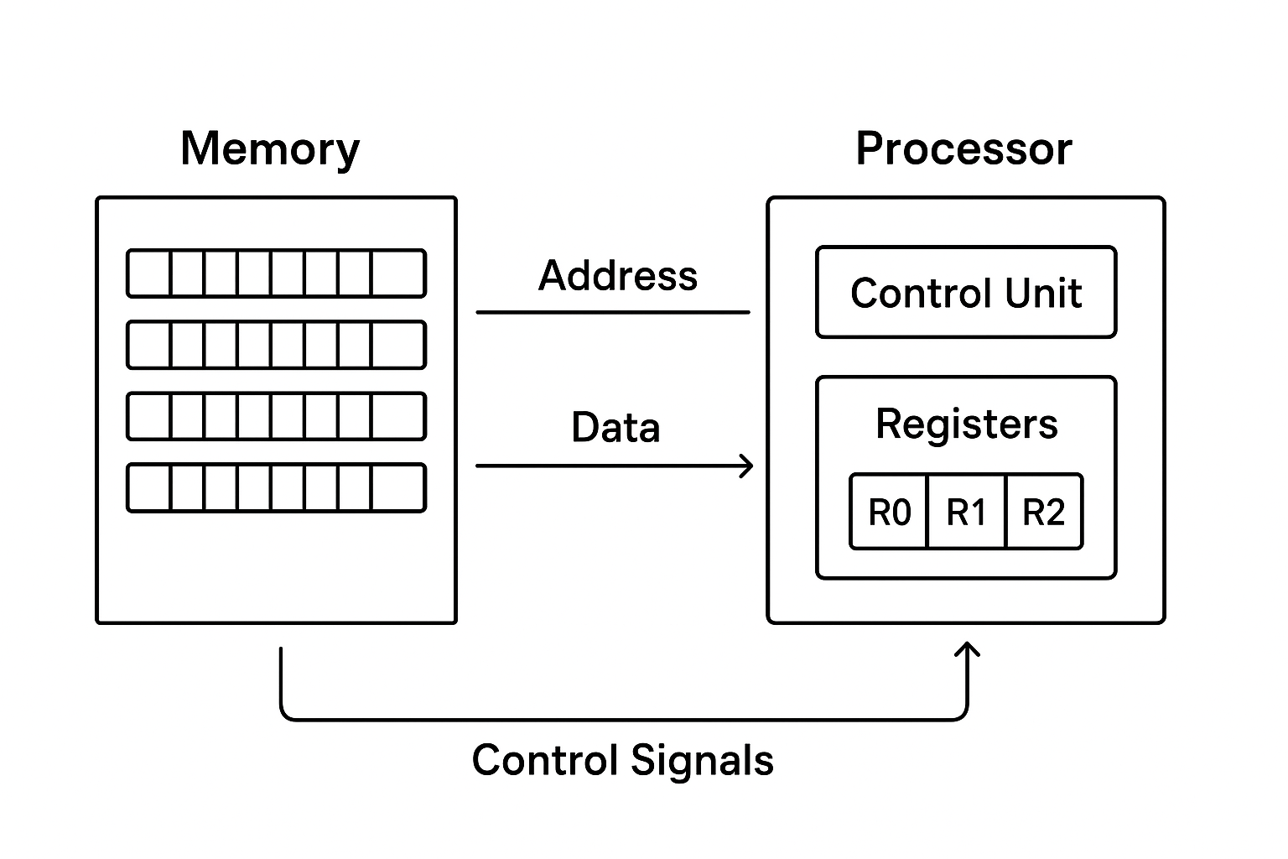

Slide 4
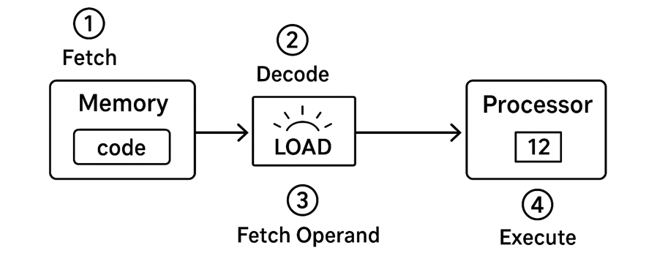
Steps to Execute LOAD R2, LOC
Fetch: Bring the instruction itself from memory into the processor.
Decode: The Control Unit determines this is a "Load" operation.
Fetch Operand: Get the data from memory address LOC.
Execute: Store that data into register R2.

Slide 5
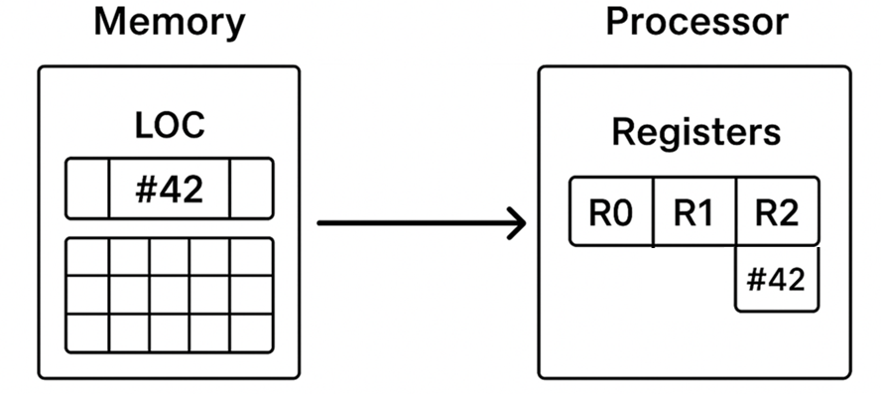
Eg: Load R2, LOC
Meaning: Copy the data from memory address LOC into processor register R2.
Key Point: Memory is read; Register R2 is overwritten.

Slide 6
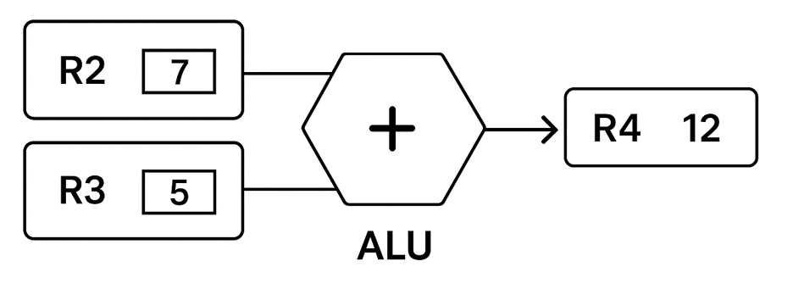
Add R4, R2, R3
Meaning: R4 ← R2 + R3
After the operands have been loaded from memory into processor registers arithmetic & logical operations can be performed.
Adds the contents of R2 and R3, places the sum in R4.
Operands (R2, R3) are preserved. Destination (R4) is overwritten.

Slide 7
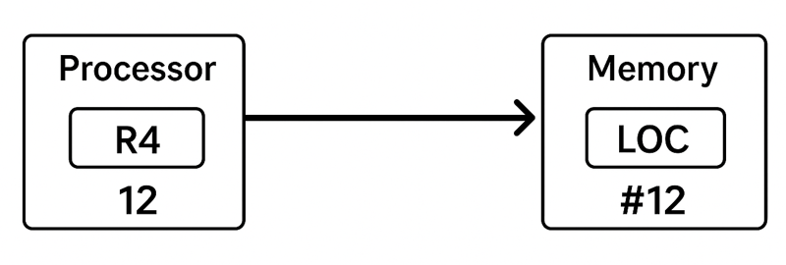
Store R4, LOC
Meaning: Copy the data from register R4 to memory address LOC.
Register R4 is read/preserved. Memory at LOC is overwritten.

Slide 8
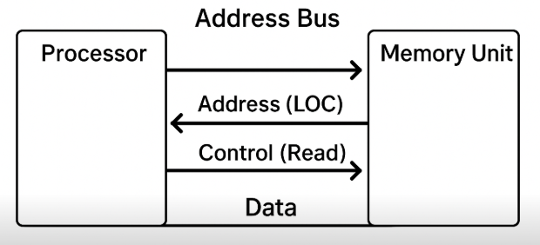
Initiating Memory Transfers (Load/Store)
For Load and Store, the processor must talk to the memory unit:
  Send the address (e.g., LOC) to the memory.
  Send the appropriate control signal (Read or Write).
  Transfer the data (to processor for Load, from processor for Store).

Slide 9
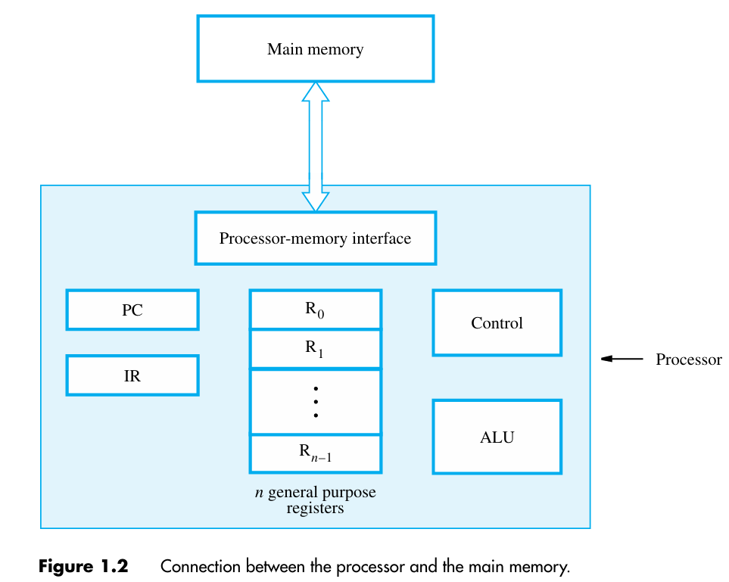
Processor Components & Memory Interface

Slide 10
The processor contains several key components
  Arithmetic Logic Unit (ALU)
  Control Circuitry
  Specialized Registers
  General-Purpose Registers
Specialized Processor Registers
  INSTRUCTION REGISTER (IR)
  Holds the instruction currently being executed
  IR makes the control circuits to generate timing signals for execution
  Once fetched from memory, the instruction is placed in IR.
  IR is the primary driver of control flow inside the CPU

Slide 11
PROGRAM COUNTER
Contains the memory address of the next instruction to be fetched and executed
Instruction Pointer – points to the next instruction
GENERAL PURPOSE REGISTERS (R0 to Rn-1)
Called as processor registers
Fast storage locations
Temporarily stores data and addresses while CPU executes instructions

Slide 12
PROCESSOR- MEMORY INTERFACE
Control circuits which manages the transfer of data between the main memory and the processor.
If a word is to be read from the memory , the interface sends the address of that word to the memory along with a Read control signal.
The interface waits for the word to be retrieved , then transfers it to the appropriate processor register.

Slide 13
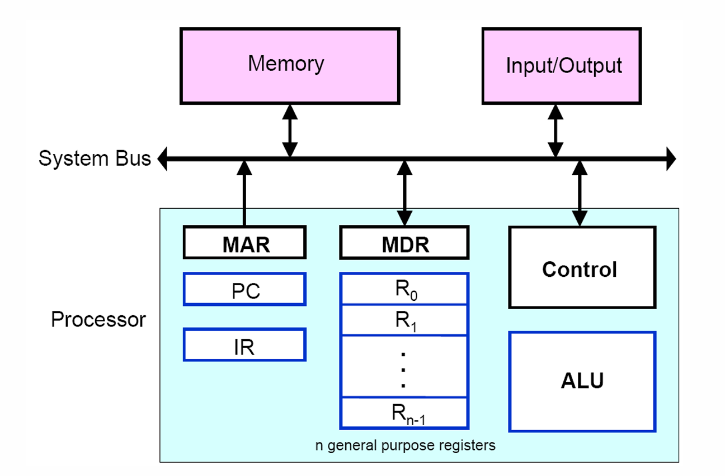

Slide 14
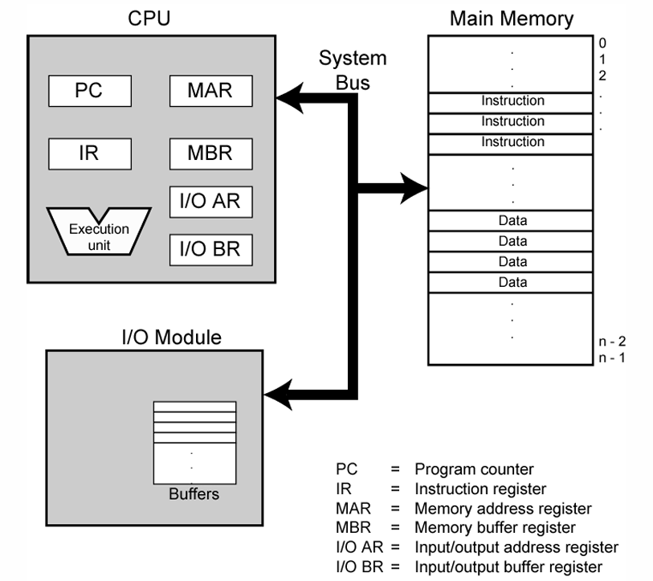
MAR :- MEMORY ADDRESS REGISTER
It holds the address of the location to be accessed
MDR :- MEMORY DATA REGISTER
It contains the data to written into or read out of the address location.
MAR & MDR facilitates the communication with the memory

Slide 15
FETCH CYCLE
Programs reside in the memory, entered through input devices
PC (Program counter) has address of the first instruction or next instruction to be executed
The contents of PC are transferred to MAR (Memory Address Register) and send over system bus to memory
A Read signal is sent to the memory by control unit
The instruction (addressed word) is fetched and loaded into MDR (Memory Data Register) after duration of memory access time
The contents of MDR transferred to IR (Instruction Register)
Now the instruction is ready to be decoded and executed

Slide 16
EXECUTION CYCLE
Get operands for ALU from:
  General-purpose register (R0, … Rn-1)
  Memory (address to MAR, Read from memory, data to MDR, to ALU)
Perform operation in ALU
Store the result back to:
  General-purpose register (R0, … Rn-1)
  Memory (address to MAR, result to MDR, Write to memory)
During the execution, PC is incremented to point to the next instruction

Slide 17
Thankyou

